Slide 1
Data Visualization using Python
Matplotlib is a comprehensive library for creating static, animated, and interactive visualizations in Python. Matplotlib makes easy things easy and hard things possible.
Create publication quality plots.
Make interactive figures that can zoom, pan, update.
Customize visual style and layout.
Export to many file formats.
Embed in JupyterLab and Graphical User Interfaces.
Use a rich array of third-party packages built on Matplotlib.

Slide 2
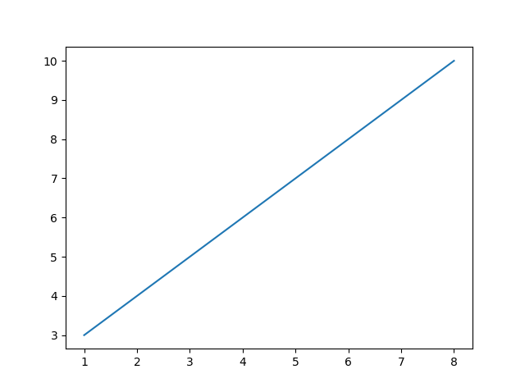
Matplotlib Plotting
The plot() function draws a line from point to point.
function takes parameters for specifying points in the diagram.
Parameter 1 is an array containing the points on the x-axis.
Parameter 2 is an array containing the points on the y-axis.
import matplotlib.pyplot as plt import numpy as np xpoints = np.array([1, 8]) ypoints = np.array([3, 10]) plt.plot(xpoints, ypoints) plt.show()
plt.plot(xpoints, ypoints, marker='o', linestyle='-')
plt.title("Simple Line Graph")
plt.xlabel("X Axis")
plt.ylabel("Y Axis")
plt.grid(True)
plt.show()

Slide 3
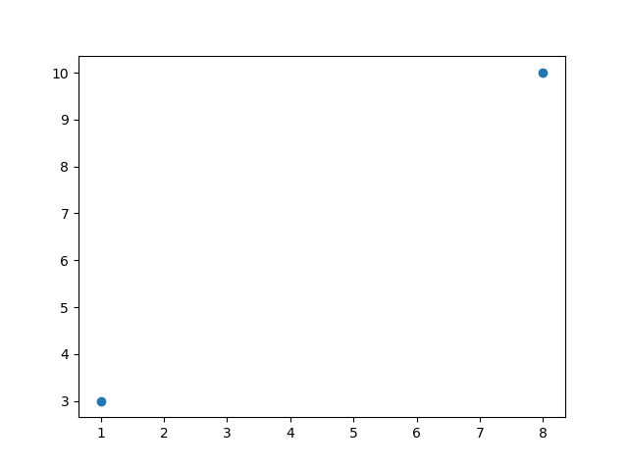
import matplotlib.pyplot as plt import numpy as np xpoints = np.array([1, 8]) ypoints = np.array([3, 10]) plt.plot(xpoints, ypoints, 'o') plt.show()
import matplotlib.pyplot as plt
import numpy as np
ypoints = np.array([3, 8, 1, 10, 5, 7])
plt.plot(ypoints, marker='o')
plt.show()

Slide 4
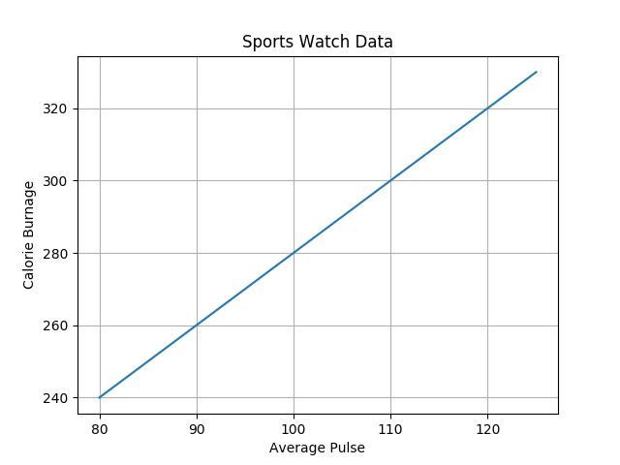
#
import numpy as np import matplotlib.pyplot as plt x = np.array([80, 85, 90, 95, 100, 105, 110, 115, 120, 125]) y = np.array([240, 250, 260, 270, 280, 290, 300, 310, 320, 330]) plt.plot(x, y)
plt.title("Sports Watch Data") plt.xlabel("Average Pulse") plt.ylabel("Calorie Burnage") plt.grid() plt.show()

Slide 5
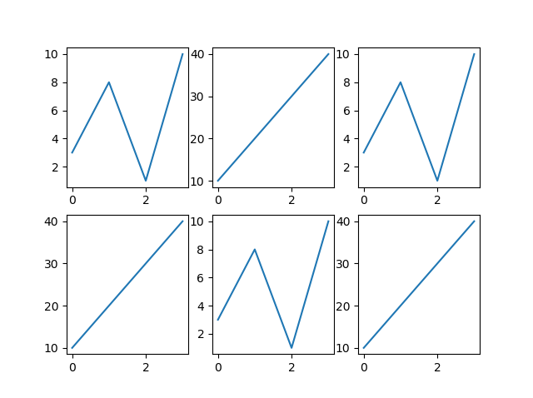
import matplotlib.pyplot as plt import numpy as np x = np.array([0, 1, 2, 3]) y = np.array([3, 8, 1, 10]) plt.subplot(2, 3, 1) plt.plot(x,y) x = np.array([0, 1, 2, 3]) y = np.array([10, 20, 30, 40]) plt.subplot(2, 3, 2) plt.plot(x,y) x = np.array([0, 1, 2, 3]) y = np.array([3, 8, 1, 10]) plt.subplot(2, 3, 3) plt.plot(x,y) x = np.array([0, 1, 2, 3]) y = np.array([10, 20, 30, 40]) plt.subplot(2, 3, 4) plt.plot(x,y) x = np.array([0, 1, 2, 3]) y = np.array([3, 8, 1, 10]) plt.subplot(2, 3, 5) plt.plot(x,y) x = np.array([0, 1, 2, 3]) y = np.array([10, 20, 30, 40]) plt.subplot(2, 3, 6) plt.plot(x,y) plt.show()

Slide 6
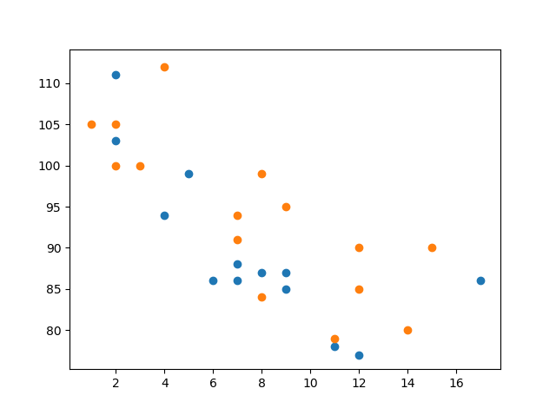
Scatter Plot
import matplotlib.pyplot as plt import numpy as np #day one, the age and speed of 13 cars: x = np.array([5,7,8,7,2,17,2,9,4,11,12,9,6]) y = np.array([99,86,87,88,111,86,103,87,94,78,77,85,86]) plt.scatter(x, y) #day two, the age and speed of 15 cars: x = np.array([2,2,8,1,15,8,12,9,7,3,11,4,7,14,12]) y = np.array([100,105,84,105,90,99,90,95,94,100,79,112,91,80,85]) plt.scatter(x, y) plt.show()

Slide 7
Bar Graph
x = np.array(["A", "B", "C", "D"]) y = np.array([3, 8, 1, 10])
#horizontal bar plt.barh(x, y)
x = np.array(["A", "B", "C", "D"]) y = np.array([3, 8, 1, 10]) #vertical bar plt.bar(x, y, color = "red") plt.show()
Although histograms and bar charts use a column-based display, they serve different purposes. A bar graph is used to compare discrete or categorical variables in a graphical format whereas a histogram depicts the frequency distribution of variables in a dataset.

Slide 8
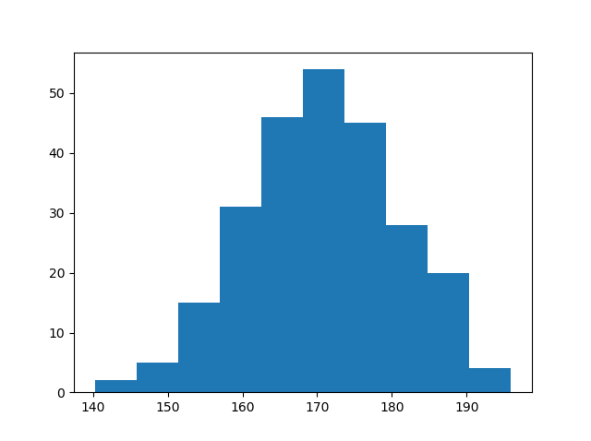
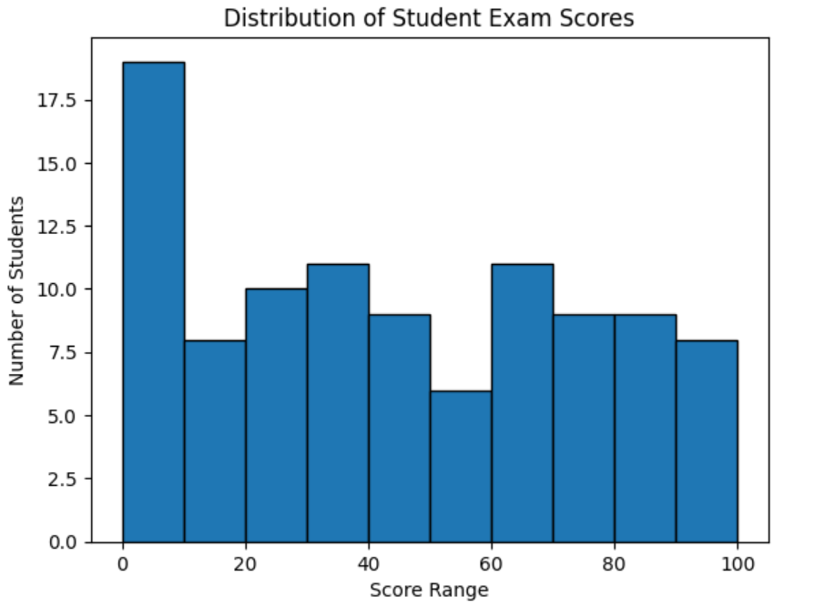
Histogram chart
import matplotlib.pyplot as plt import numpy as np x = np.random.normal(170, 10, 250) plt.hist(x) plt.show()
import matplotlib.pyplot as plt
import numpy as np
scores = np.random.randint(0, 101, size=100)
plt.hist(scores, bins=10, edgecolor='black')
plt.title("Distribution of Student Exam Scores")
plt.xlabel("Score Range")
plt.ylabel("Number of Students")
plt.show()

Slide 9
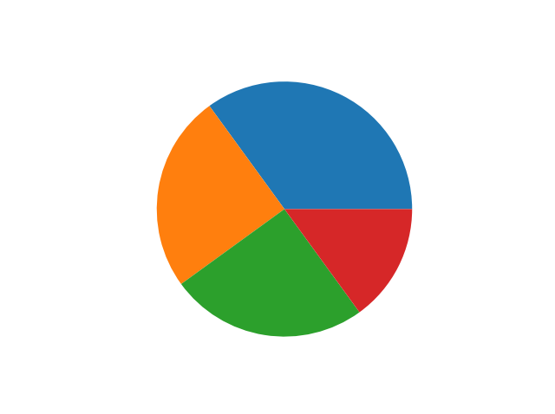
Pie-Chart
import matplotlib.pyplot as plt import numpy as np y = np.array([35, 25, 25, 15]) plt.pie(y) plt.show()
Matplotlib Pie Charts (w3schools.com)

Slide 10
Data Visualization as preprocessing step
Data visualization as a preprocessing step is important step in the designing of data mining tools. Visualization is necessary to perform analysis and visualize patterns, cycles, trends in the dataset.
The steps used in data preprocessing include the following:
Data profiling. Data profiling is the process of examining, analyzing and reviewing data to collect statistics about its quality. ...
Data cleansing. ...
Data reduction. ...
Data transformation. ...
Data enrichment. ...
Data validation
What are the 5 steps in data visualization?
Step 1 — Be clear on the question. ...
Step 2 — Know your data and start with basic visualizations. ...
Step 3 — Identify messages of the visualization, and generate the most informative.
Step 4 — Choose the right chart type. ...
Step 5 — Use color, size, scale, shapes and labels to direct attention to the key.

Slide 11
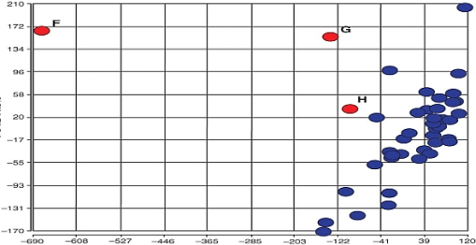
Data Visualization at preprocessing stage
To understand the data
Create Delhi pollution rate for three years
Draw the graph and identify the month in which pollution is high
To find Outliers

Slide 12
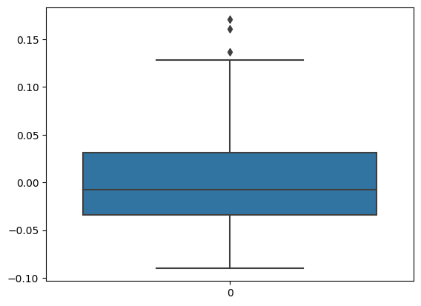
_
import seaborn as sns
import matplotlib.pyplot as plt
def removal_box_plot(df, column, threshold):
sns.boxplot(df[column])
plt.title(f'Original Box Plot of {column}')
plt.show()
removed_outliers = df[df[column] <= threshold]
sns.boxplot(removed_outliers[column])
plt.title(f'Box Plot without Outliers of {column}')
plt.show()
return removed_outliers
threshold_value = 0.12
no_outliers = removal_box_plot(df_diabetics, 'bmi', threshold_value)
Remove outliers using scatter plot

Slide 13
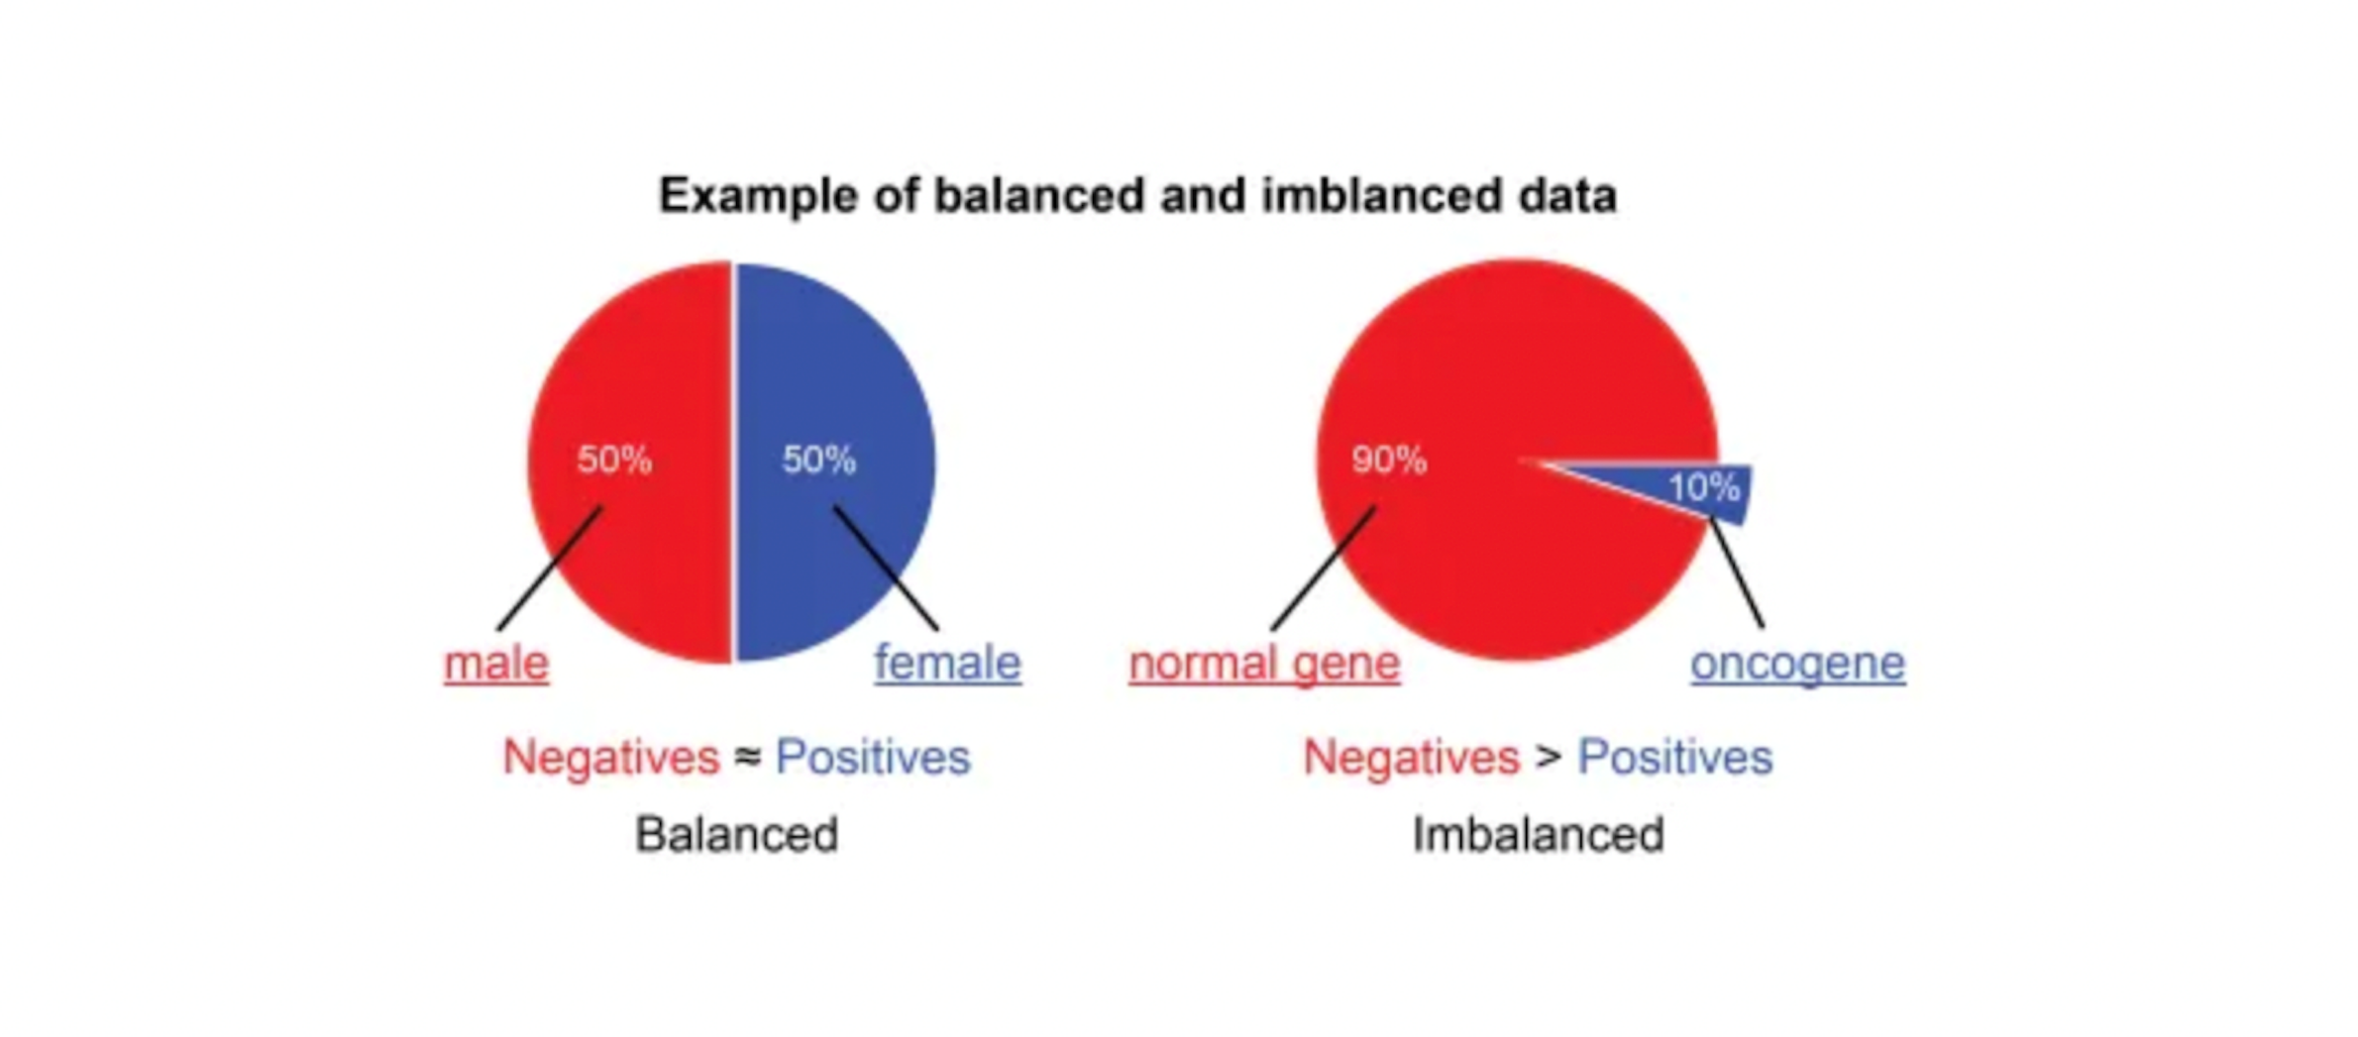
Imbalanced data
How will you find imbalanced data? feature to be used to find imbalanced data

Slide 14
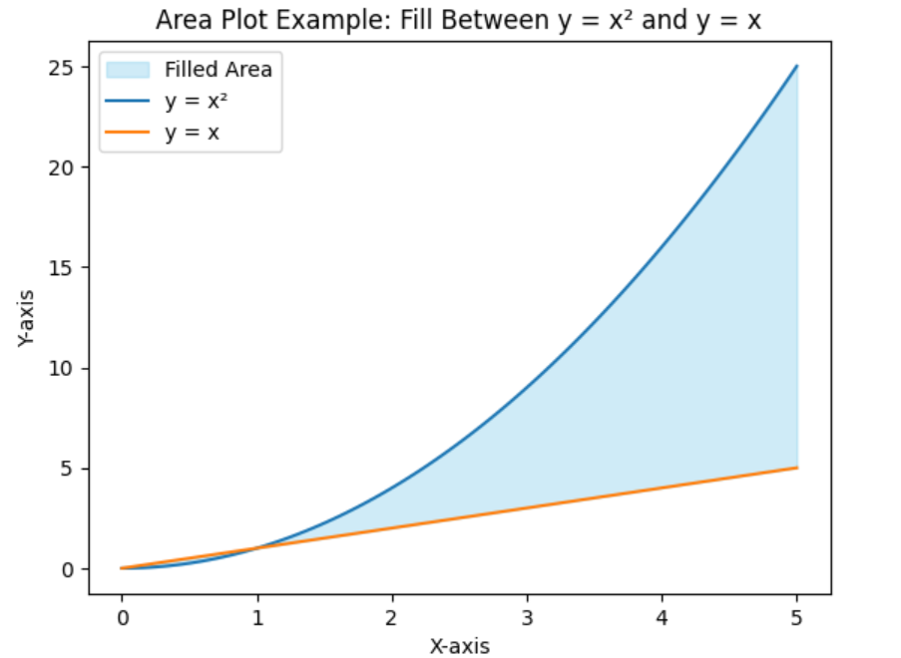
import matplotlib.pyplot as plt
import numpy as np
# Generate sample data
x = np.linspace(0, 5, 100)
y1 = x**2
y2 = x
# Fill the area between y1 and y2
plt.fill_between(x, y1, y2, color='skyblue', alpha=0.4, label='Filled Area')
# Plot the curves
plt.plot(x, y1, label='y = x²')
plt.plot(x, y2, label='y = x')
# Add labels and title
plt.xlabel('X-axis')
plt.ylabel('Y-axis')
plt.title('Area Plot Example: Fill Between y = x² and y = x')
plt.legend()
plt.show()

